Slide 1
Session Tracking in Servlets
Exp:Write a program in servlet for session tracking using cookies

Slide 2
Session simply means a particular interval of time.
Session Tracking is a way to maintain state (data) of an user. It is also known as session management in servlet.
Http protocol is a stateless so we need to maintain state using session tracking techniques. Each time user requests to the server, server treats the request as the new request. So we need to maintain the state of an user to recognize to particular user.

Slide 3
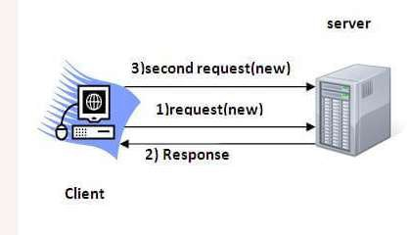
HTTP is stateless that means each request is considered as the new request. It is shown in the figure given below:

Slide 4
Why use Session Tracking?
To recognize the user It is used to recognize the particular user.
Session Tracking Techniques
There are four techniques used in Session tracking:
Cookies
Hidden Form Field
URL Rewriting
HttpSession

Slide 5
Cookies in Servlet
A cookie is a small piece of information that is persisted between the multiple client requests.
A cookie has a name, a single value, and optional attributes such as a comment, path and domain qualifiers, a maximum age, and a version number.

Slide 6
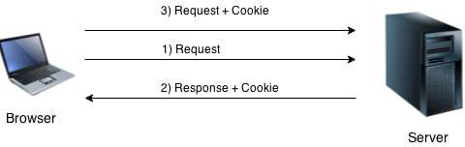
How Cookie works
By default, each request is considered as a new request. In cookies technique, we add cookie with response from the servlet. So cookie is stored in the cache of the browser. After that if request is sent by the user, cookie is added with request by default. Thus, we recognize the user as the old user.

Slide 7
Types of Cookie
There are 2 types of cookies in servlets.
Non-persistent cookie
Persistent cookie
Non-persistent cookie
It is valid for single session only. It is removed each time when user closes the browser.
Persistent cookie
It is valid for multiple session . It is not removed each time when user closes the browser. It is removed only if user logout or signout.

Slide 8
Advantage of Cookies
Simplest technique of maintaining the state.
Cookies are maintained at client side.
Disadvantage of Cookies
It will not work if cookie is disabled from the browser.
Only textual information can be set in Cookie object.

Slide 9
Cookie class
javax.servlet.http.Cookie class provides the functionality of using cookies. It provides a lot of useful methods for cookies.

Slide 10
Constructor of Cookie class
Constructor | Description
Cookie() | constructs a cookie.
Cookie(String name, String value) | constructs a cookie with a specified name and value.

Slide 11
Useful Methods FoR Cookie class
Method | Description
public void setMaxAge(int expiry) | Sets the maximum age of the cookie in seconds.
public String getName() | Returns the name of the cookie. The name cannot be changed after creation.
public String getValue() | Returns the value of the cookie.
public void setName(String name) | changes the name of the cookie.
public void setValue(String value) | changes the value of the cookie.

Slide 12
How to create Cookie?
Cookie ck=new Cookie("user","sonoo jaiswal"
);//creating cookie object
response.addCookie(ck);//adding cookie in th e response

Slide 13
How to delete Cookie?
Cookie ck=new Cookie("user","");//deleting value of cookie
ck.setMaxAge(0);//changing the maximum age to 0 seconds
response.addCookie(ck);//adding cookie in the re sponse

Slide 14
How to get Cookies?
Cookie ck[]=request.getCookies();
for(int i=0;i<ck.length;i++){
out.print("<br>"+ck[i].getName()+" "+ck[i].get Value());//printing name and value of cookie
}

Slide 15
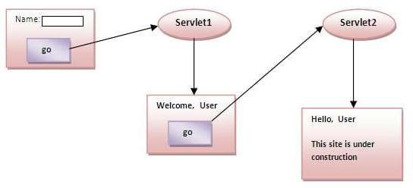
Simple example of Servlet Cookies
In this example, we are storing the name of the user in the cookie object and accessing it in another servlet. As we know well that session corresponds to the particular user. So if you access it from too many browsers with different values, you will get the different value.

Slide 16
index.html
<form action="servlet1" method="post">
Name:<input type="text" name="userName"/><br/
>
<input type="submit" value="go"/>
</form>

Slide 17
FirstServlet.java
import java.io.*;
import javax.servlet.*;
import javax.servlet.http.*;
public class FirstServlet extends Htt
pServlet {
public void doPost(HttpServletRequ est request, HttpServletResponse res ponse){
try{
response.setContentType("text/htm l");
PrintWriter out = response.getWrite r();
String n=request.getParameter("us
erName"); out.print("Welcome "+n);
Cookie ck=new Cookie("uname",n);// creating cookie object
response.addCookie(ck);//adding c ookie in the response
//creating submit button out.print("<form action='servlet2'>")
;
out.print("<input type='submit' valu
e='go'>");
out.print("</form>");
out.close();
}catch(Exception e){System.out.
println(e);}
}
}

Slide 18
SecondServlet.java
import java.io.*;
import javax.servlet.*;
import javax.servlet.http.*;
public class SecondServlet extends HttpServlet {
public void doPost(HttpServletRequest request, HttpServletResponse response){
try{
response.setContentType("text/html"); PrintWriter out = response.getWriter();
Cookie ck[]=request.getCookies(); out.print("Hello "+ck[0].getValue());
out.close();
}catch(Exception e){System.out.println(e);}
}
}

Slide 19
web.xml
<web-app> <servlet> <servlet-name>s1</servlet-name> <servlet-class>FirstServlet</servlet- class> </servlet> | <servlet> <servlet-name>s2</servlet-name> <servlet- class>SecondServlet</servlet- class> </servlet>
<servlet-mapping> <servlet-name>s1</servlet-name> <url-pattern>/servlet1</url-pattern> </servlet-mapping> | <servlet-mapping> <servlet-name>s2</servlet-name> <url-pattern>/servlet2</url-pattern> </servlet-mapping>
 | </web-app>

